Slide 1
CS152 Section 6
Out-of-Order Execution

Slide 2
Agenda
Brief Midterm 1 retrospective
Out-of-order execution

Slide 3
Administrivia
Lab 2 due Monday, March 8
PS3 due Monday, March 15

Slide 4
Why is Out-of-Order Execution Useful?
Exploit instruction-level parallelism (ILP) to keep processor busy
Make suboptimal code run fast
Dynamically schedule around long-latency instructions ld x2, 0(x1) # cache miss: 200 cycles add x5, x3, x4 ld x7, 4(x6)
Initiate long-latency instructions earlier

Slide 5
What Limits OoO Performance?
A: fmul f1, f0, f2
B: fadd f0, f3, f1
C: fmul f3, f2, f3
D: fadd f3, f3, f1
Want to issue instruction C right after A, but cannot reorder it earlier due to WAR hazard on B (f3)
Suppose only four F registers exist, and it is not feasible for compiler to choose f2 as the destination of C since f2 is read by a later instruction

Slide 6
What Limits OoO Performance?
WAW/WAR hazards
Caused by reuse of limited set of architectural (named) registers
Would not exist if an infinite number of registers were available
Not a “true” data dependency
How can x86 (8 “GPRs”) and x86-64 (16 GPRs) implementations achieve high performance?
How can we use more registers than what the ISA specifies?

Slide 7
Register Renaming
Main idea: Decouple architectural registers (used for expressing dataflow) from physical registers (used for storage)
For each in-flight instruction, rename the destination register with a unique tag that refers to a separate buffer to hold result
Somehow maintain relationship between tags and ISA registers
“All problems in computer science can be solved by another level of indirection”

Slide 8
Register Renaming
Rename Table
 | Initial | Final
f0 | P0 | P5
f1 | P1 | P4
f2 | P2 | P2
f3 | P3 | P7
A: fmul f1, f0, f2
B: fadd f0, f3, f1
C: fmul f3, f2, f3
D: fadd f3, f3, f1
fmul P4, P0, P2
fadd P5, P3, P4
fmul P6, P2, P3
fadd P7, P6, P4
Resembles single static assignment (SSA) form

Slide 9
Tomasulo’s Algorithm
On instruction dispatch (in program order):
Allocate reservation station (RS) entry
If source register has “present” (P) bit set in register file (RF) entry, copy value into tag/data field in RS and set P bit for operand
Otherwise, copy tag from RF into RS and clear P bit for operand
Replace RF entry for destination register with tag assigned to RS entry (tag_{dest})
Prior to execution:
For missing operands, monitor result bus for tag match; replace tag with value; set P
When all operands are present, issue to functional unit
On completion:
Broadcast <tag_{dest}, result> on result bus for RF and other RS entries to consume
Deallocate RS entry

Slide 10
Tomasulo’s Algorithm (Q1)
Simulate execution of the following code using Tomasulo’s Algorithm:
A: fmul f1, f0, f2 # produces value V3 B: fadd f0, f3, f1 # produces value V4 C: fmul f3, f2, f3 # produces value V5 D: fadd f3, f3, f1 # produces value V6
At most one instruction dispatched per cycle
Can begin execution the same cycle as dispatch if all operands are present
Fully-pipelined functional units
2-cycle floating-point add latency
3-cycle floating-point multiply latency
Broadcasting result takes another cycle
Result bus can broadcast two results simultaneously

Slide 11
Cycle 1
On instruction dispatch (in program order):
Allocate reservation station (RS) entry
If source register has “present” (P) bit set in register file (RF) entry, copy value into tag/data field in RS and set P bit for operand
Otherwise, copy tag from RF into RS and clear P bit for operand
Replace RF entry for destination register with tag assigned to RS entry (tag_{dest})
Dispatched instruction: A
Reservation Stations
 | p | tag/data | p | tag/data
T0
T1
T2
Reservation Stations
 | p | tag/data | p | tag/data
T3
T4
Register File
 | p | tag/data
f0 | 1 | V0
f1
f2 | 1 | V1
f3 | 1 | V2
Multiplier
stage | dest tag
1
2
3
Adder
stage | dest tag
1
2
A: fmul f1, f0, f2 # V3 B: fadd f0, f3, f1 # V4 C: fmul f3, f2, f3 # V5 D: fadd f3, f3, f1 # V6

Slide 12
Cycle 2
On instruction dispatch (in program order):
Allocate reservation station (RS) entry
If source register has “present” (P) bit set in register file (RF) entry, copy value into tag/data field in RS and set P bit for operand
Otherwise, copy tag from RF into RS and clear P bit for operand
Replace RF entry for destination register with tag assigned to RS entry (tag_{dest})
Dispatched instruction: B
Reservation Stations
 | p | tag/data | p | tag/data
T0
T1
T2
Reservation Stations
 | p | tag/data | p | tag/data
T3
T4
Register File
 | p | tag/data
f0
f1
f2 | 1 | V1
f3 | 1 | V2
Multiplier
stage | dest tag
1
2
3
Adder
stage | dest tag
1
2
A: fmul f1, f0, f2 # V3 B: fadd f0, f3, f1 # V4 C: fmul f3, f2, f3 # V5 D: fadd f3, f3, f1 # V6

Slide 13
Cycle 3
On instruction dispatch (in program order):
Allocate reservation station (RS) entry
If source register has “present” (P) bit set in register file (RF) entry, copy value into tag/data field in RS and set P bit for operand
Otherwise, copy tag from RF into RS and clear P bit for operand
Replace RF entry for destination register with tag assigned to RS entry (tag_{dest})
Dispatched instruction: C
Reservation Stations
 | p | tag/data | p | tag/data
T0
T1
T2
Reservation Stations
 | p | tag/data | p | tag/data
T3
T4
Register File
 | p | tag/data
f0
f1
f2 | 1 | V1
f3
Multiplier
stage | dest tag
1
2
3
Adder
stage | dest tag
1
2
A: fmul f1, f0, f2 # V3 B: fadd f0, f3, f1 # V4 C: fmul f3, f2, f3 # V5 D: fadd f3, f3, f1 # V6

Slide 14
Cycle 4
On completion:
Broadcast <tag_{dest}, result> on result bus for RF and other RS entries to consume
Deallocate RS entry
For missing operands, monitor result bus for tag match; replace tag with value; set P
Dispatched instruction: D
Reservation Stations
 | p | tag/data | p | tag/data
T0
T1
T2
Reservation Stations
 | p | tag/data | p | tag/data
T3
T4
Register File
 | p | tag/data
f0
f1
f2 | 1 | V1
f3
Multiplier
stage | dest tag
1
2
3
Adder
stage | dest tag
1
2
A: fmul f1, f0, f2 # V3 B: fadd f0, f3, f1 # V4 C: fmul f3, f2, f3 # V5 D: fadd f3, f3, f1 # V6

Slide 15
Cycle 5
On completion:
Broadcast <tag_{dest}, result> on result bus for RF and other RS entries to consume
Deallocate RS entry
For missing operands, monitor result bus for tag match; replace tag with value; set P
Dispatched instruction: N/A
Reservation Stations
 | p | tag/data | p | tag/data
T0
T1
T2
Reservation Stations
 | p | tag/data | p | tag/data
T3
T4
Register File
 | p | tag/data
f0
f1
f2 | 1 | V1
f3
Multiplier
stage | dest tag
1
2
3
Adder
stage | dest tag
1
2
A: fmul f1, f0, f2 # V3 B: fadd f0, f3, f1 # V4 C: fmul f3, f2, f3 # V5 D: fadd f3, f3, f1 # V6

Slide 16
Cycle 6
On completion:
Broadcast <tag_{dest}, result> on result bus for RF and other RS entries to consume
Deallocate RS entry
For missing operands, monitor result bus for tag match; replace tag with value; set P
Dispatched instruction: N/A
Reservation Stations
 | p | tag/data | p | tag/data
T0
T1
T2
Reservation Stations
 | p | tag/data | p | tag/data
T3
T4
Register File
 | p | tag/data
f0
f1
f2 | 1 | V1
f3
Multiplier
stage | dest tag
1
2
3
Adder
stage | dest tag
1
2
A: fmul f1, f0, f2 # V3 B: fadd f0, f3, f1 # V4 C: fmul f3, f2, f3 # V5 D: fadd f3, f3, f1 # V6

Slide 17
Tomasulo’s Algorithm
Q: Why can’t the reservation station entry for an instruction be deallocated immediately on issue?
A: fmul f4, f0, f1 # Dispatched and issued immediately; RS is freed B: fmul f5, f2, f3 # Allocated same RS as A before A has written back
f4 and f5 now assigned the same tag in regfile, causing instruction A to incorrectly clobber f5 on writeback

Slide 18
Tomasulo’s Algorithm
Q: Why are exceptions imprecise in this implementation?
Register file is irrevocably modified on dispatch
No mechanism to recover original value of destination register if instruction causes an exception

Slide 19
How to Regain Precise Exceptions?
Reorder Buffer (ROB) separates commit from completion:
Completion: Result available (out-of-order)
Commit: Architectural state updated (in-order)
v | i | op | p | rs1/tag | p | rs2/tag | p | result | rd | xcpt?
oldest
free

Slide 20
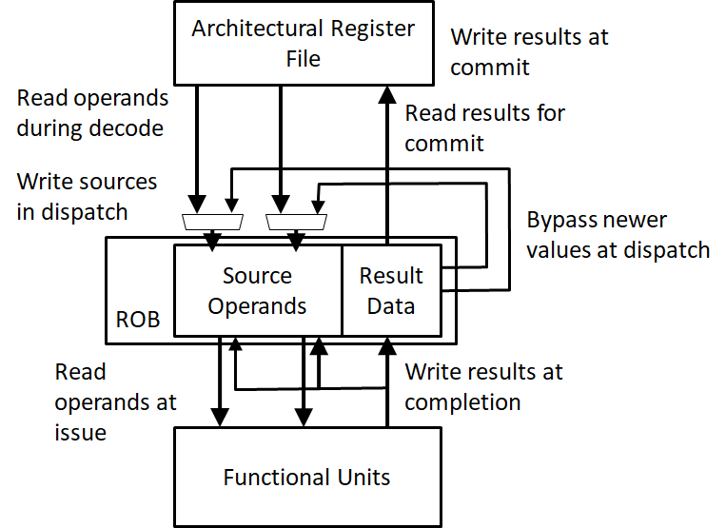
Data-in-ROB
ROB holds both tags and data
Separate architectural register file

Slide 21
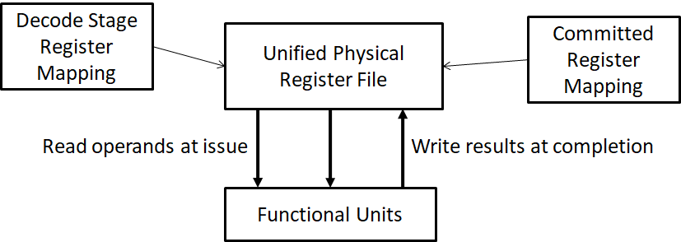
Unified Physical Register File
Physical register file holds both committed and temporary values
Only tags held in ROB

Slide 22
Renaming with Unified PRF (Q2)
On dispatch:
Allocate new physical register for destination from free list
Update decode-stage mapping
On commit:
Update architectural mapping
Deallocate previous physical register for destination; re-add to free list
On exception:
Repair decode-stage rename table by un-renaming in reverse order; walk through ROB entries from newest to oldest (MIPS R10k approach)

Slide 23
Renaming with Unified PRF (Q2)
Free List
p2
p4
p10
p7
p1
p0
p9
p8
p13
p14
Instruction | Architectural Destination Register | Physical Destination Register | Freed Register
ld x2, 0(x4) | x2 | p2 | p11
sw x2, 0(x3)
addi x4, x4, 0x4
addi x3, x3, 0x4
bne x4, x1, loop
ld x2, 0(x4)
sw x2, 0(x3)
addi x4, x4, 0x4
addi x3, x3, 0x4
bne x4, x1, loop
Initial Map Table
Architectural Register | Physical Register
x1 | p12
x2 | p11
x3 | p5
x4 | p6
x5 | p3

Slide 24
Renaming with Unified PRF (Q2)
Suppose the second load instruction caused an exception. Show the state of the map table and free list before jumping to the exception handler.
Map Table
Architectural Register | Physical Register
x1
x2
x3
x4
x5
Free List

